Slide 1

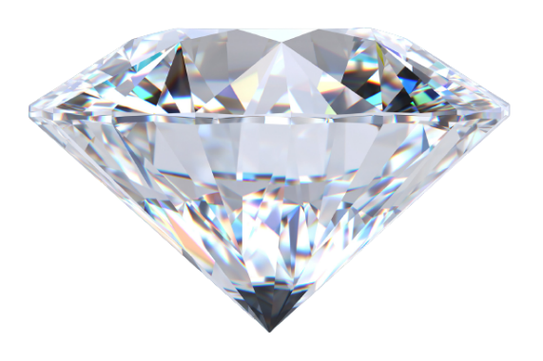
SHAI For AI | شاي للذكاء الاصطناعي
Diamond Price Prediction
Project done by:
Imane ASSKOUR | Abdulrahman Khalid
Mohammed Salah | Boshra nasser

Slide 2
Introduction | 01
Dataset’s Presentation | 02
Exploratory Data Analysis (EDA) | 03
Data Cleaning & Preprocessing | 04
Modeling | 05
Conclusion | 06
Project Presentation Outline

Slide 3
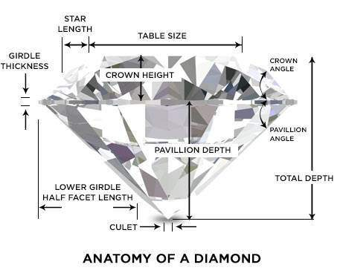
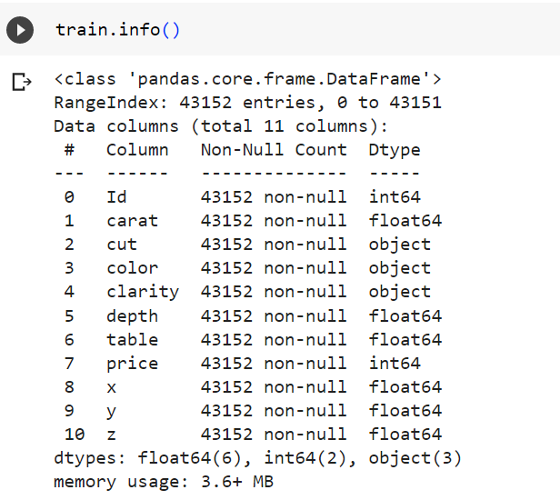
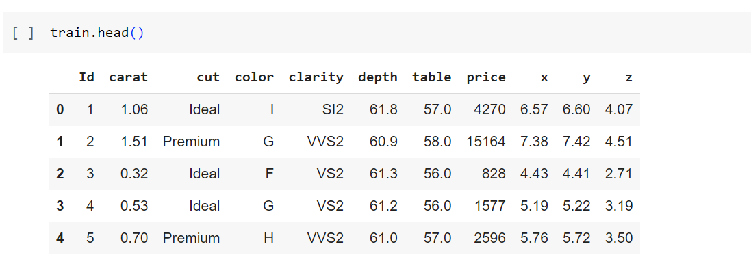
Introduction
Dataset’s presentation

Slide 4
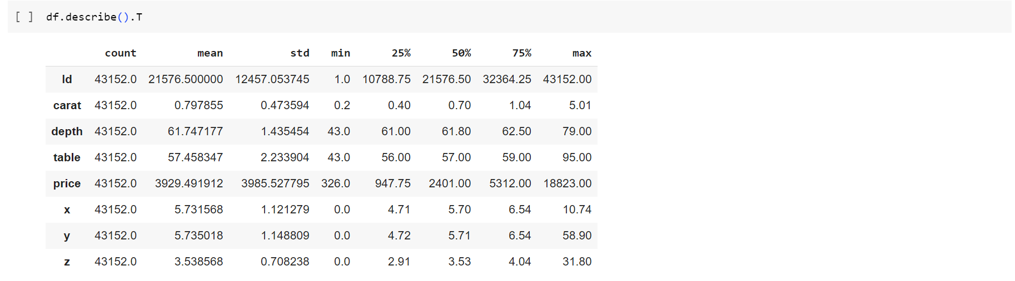
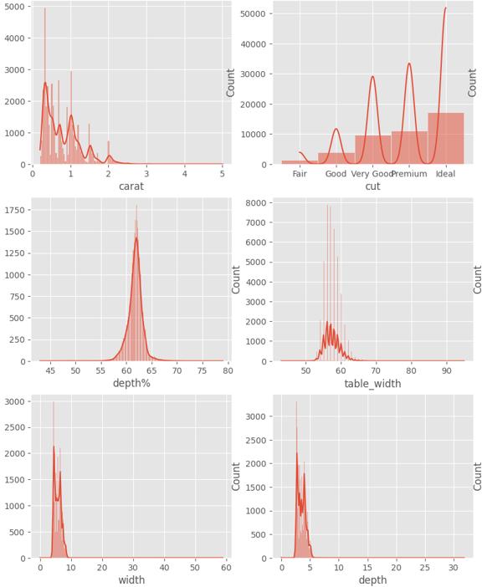
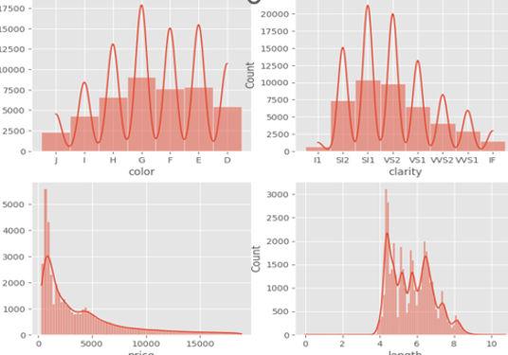
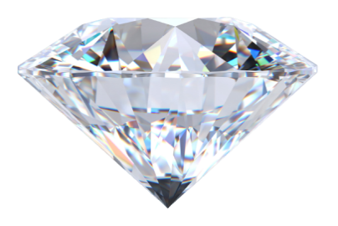
Describing Features

Slide 5
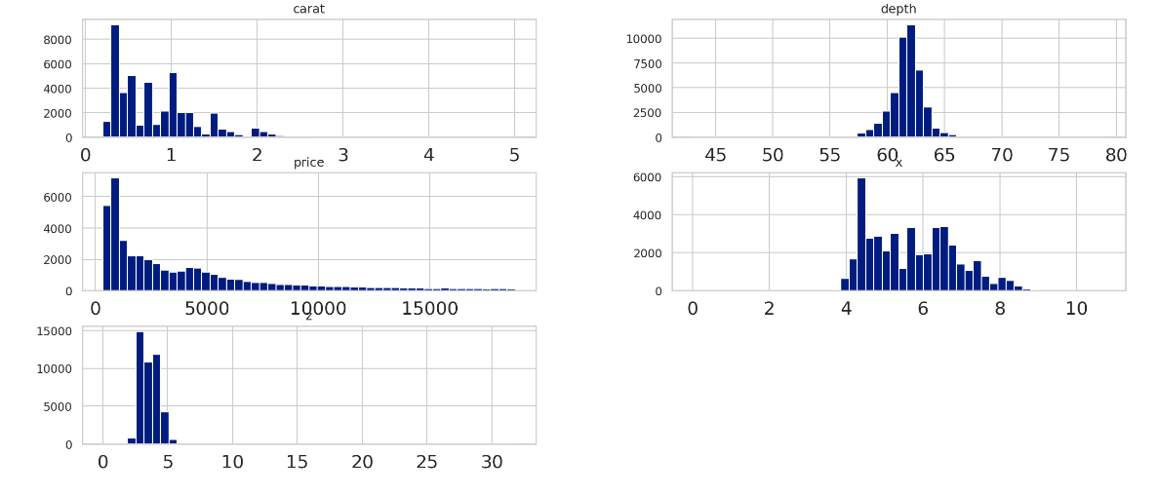
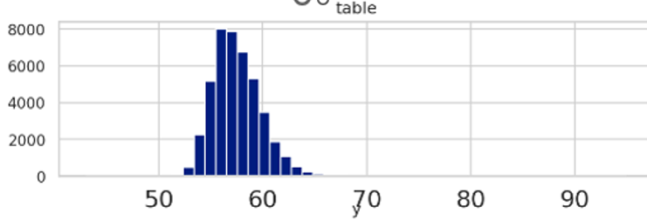
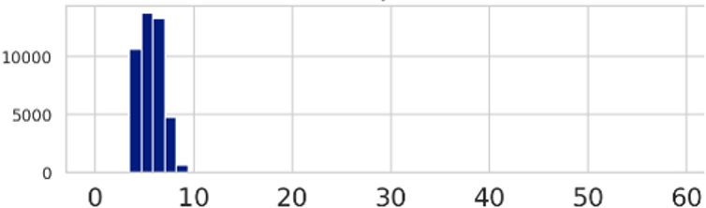
Exploratory Data Analysis (EDA)
Univariate and Bivariate Data Exploration.

Slide 6
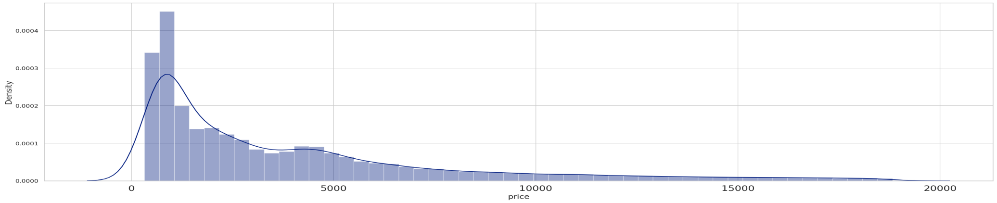
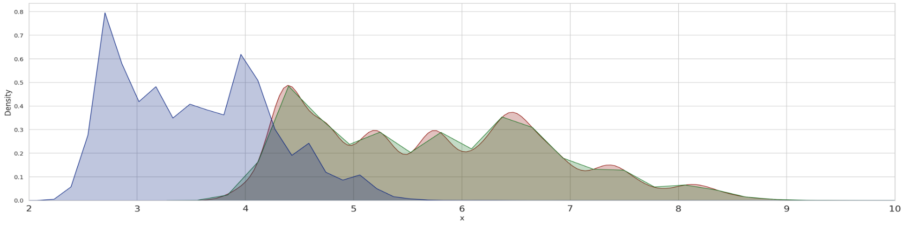
Exploratory Data Analysis (EDA)
Diamonds Prices Distribution
Dimensions:

Slide 7
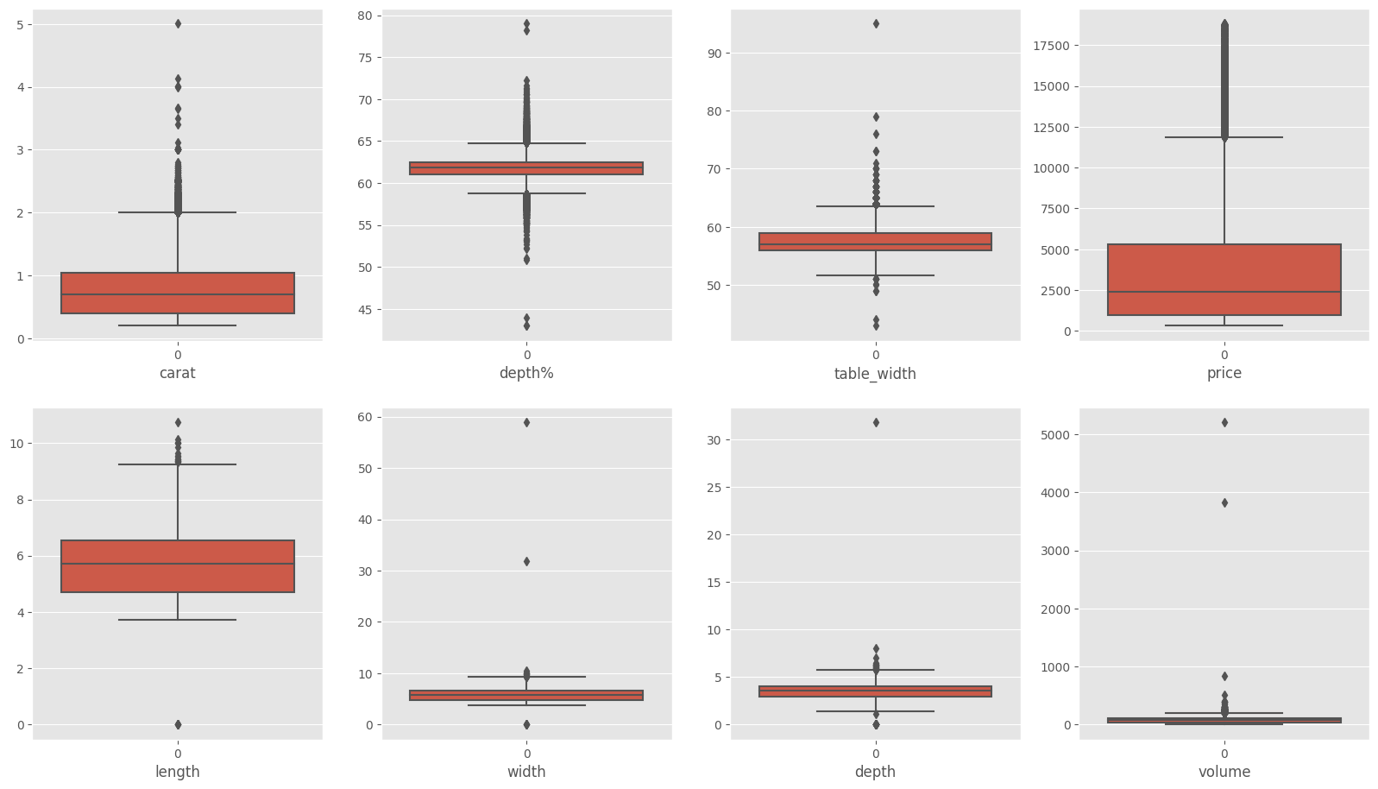
Data Cleaning & Preprocessing
Data distribution:
We could divide our features to 3 groups:
Features that are normally(or almost) distributed: ['depth','lenght']
Positvely Right Skewed Features (near zero values) that can be transformed: ['carat','table_width','price','width','depth','volume']
Ordinal Categorical Features that we encoded: ['cut','color','clarity']
We may want to look at outliers in the ['width','depth','table_width','depth%','volume'] features by removing or imputing them.

Slide 8
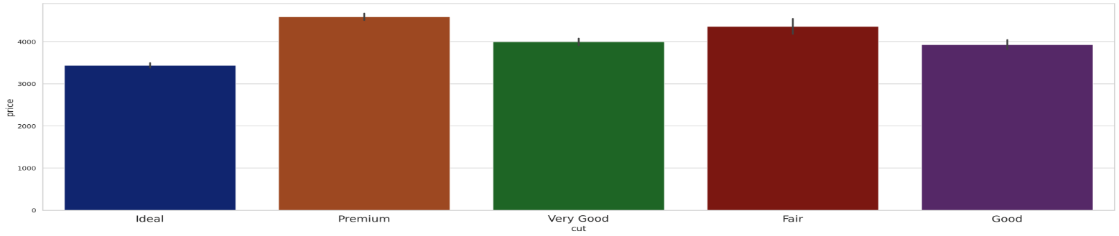
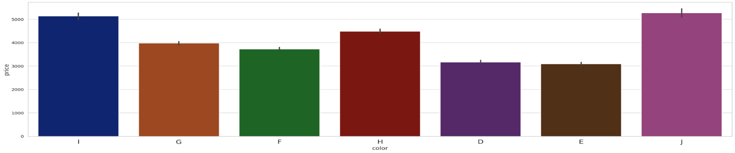
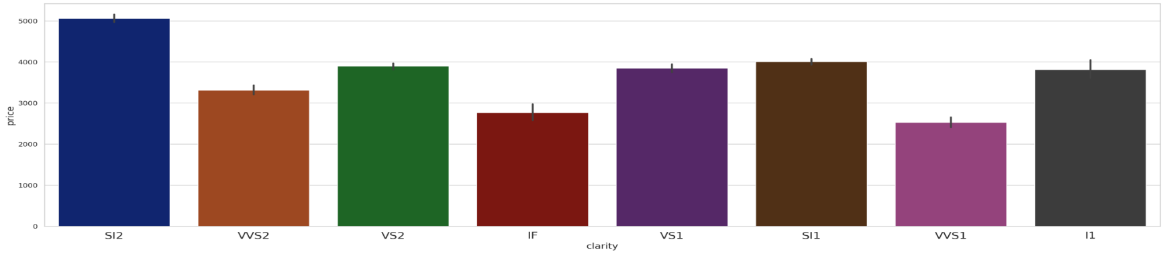
Exploratory Data Analysis (EDA)
Diamond CUT:
Diamond COLOR:
CLARITY:

Slide 9
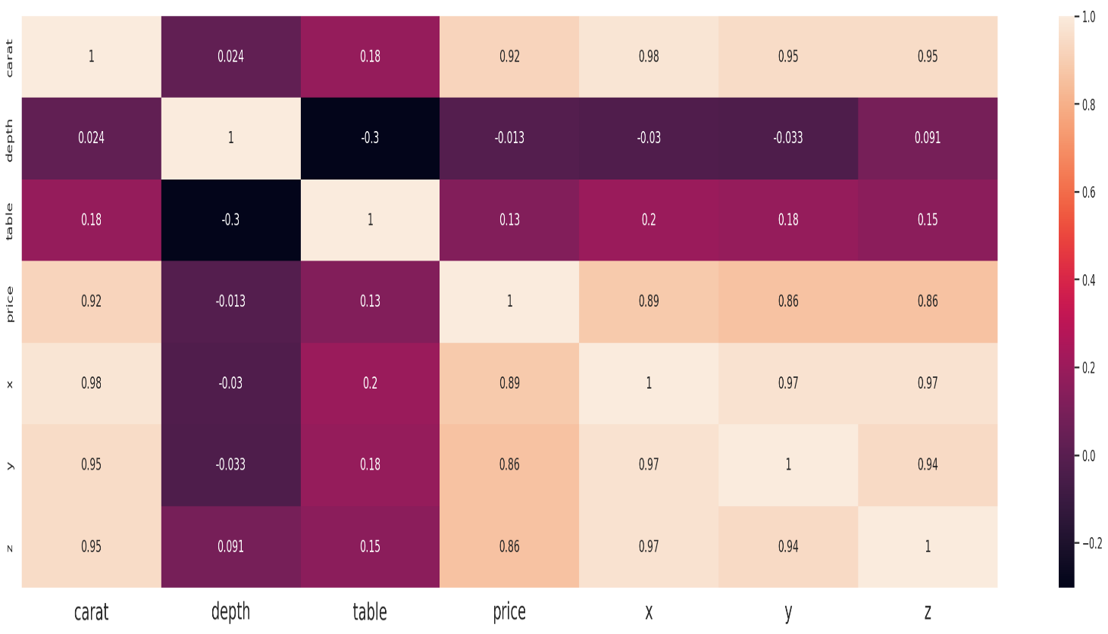
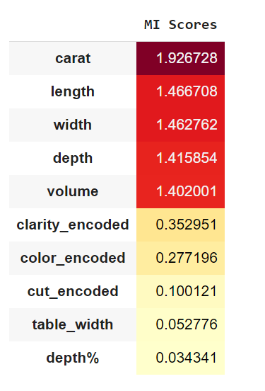
Exploratory Data Analysis (EDA)
Correlation Matrix:
Shows Linear Relations
MI Scores shows non linear with target
* Depth is inversely related to Price.
* The Price of the Diamond is highly correlated to Carat, and its Dimensions.
* The Weight (Carat) of a diamond has the most significant impact on its Price.
* The Length(x) , Width(y) and Height(z) seems to be highly related to
Price and even each other.
* Self Relation of a feature to itself is 1 as expected.

Slide 10
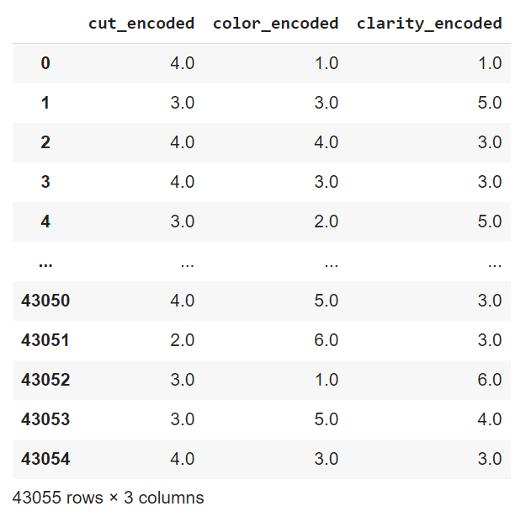
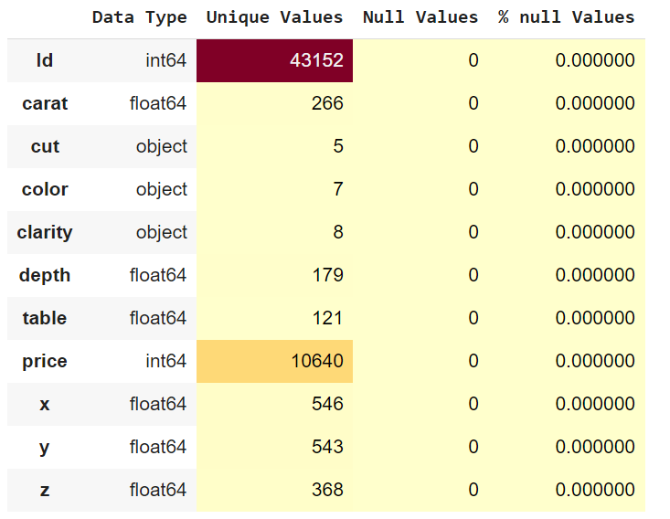
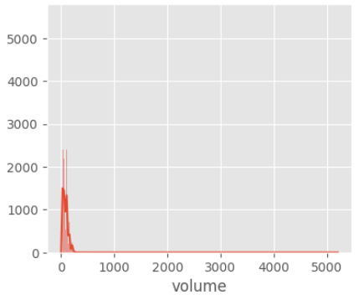
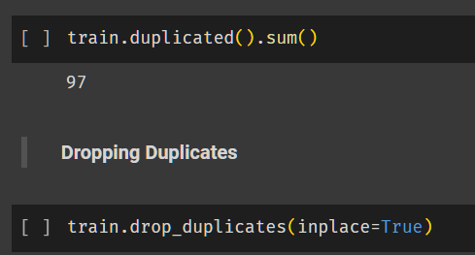
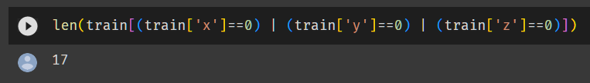
Data Cleaning & Preprocessing
Categorical Features Encoding
Look for null values:
Creating New Volume Feature
Handling Duplicates
We've noticed that some X , Y and Z rows contain value O which don't make any sense to have either of Length or Width or Height to be zero, so we'll drop them

Slide 11
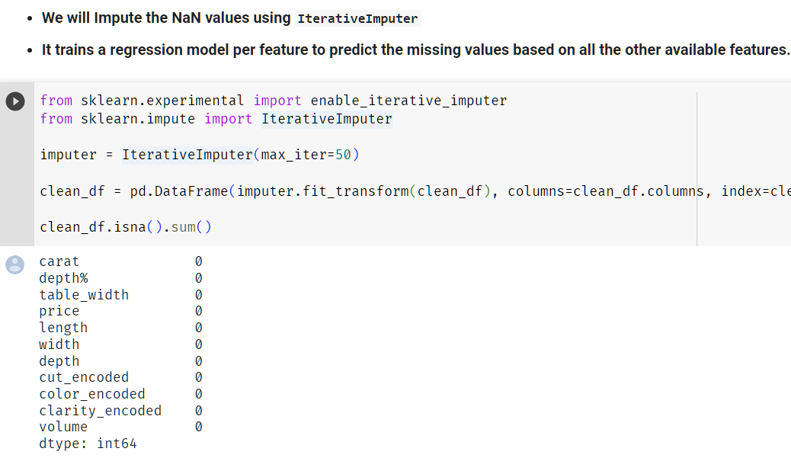
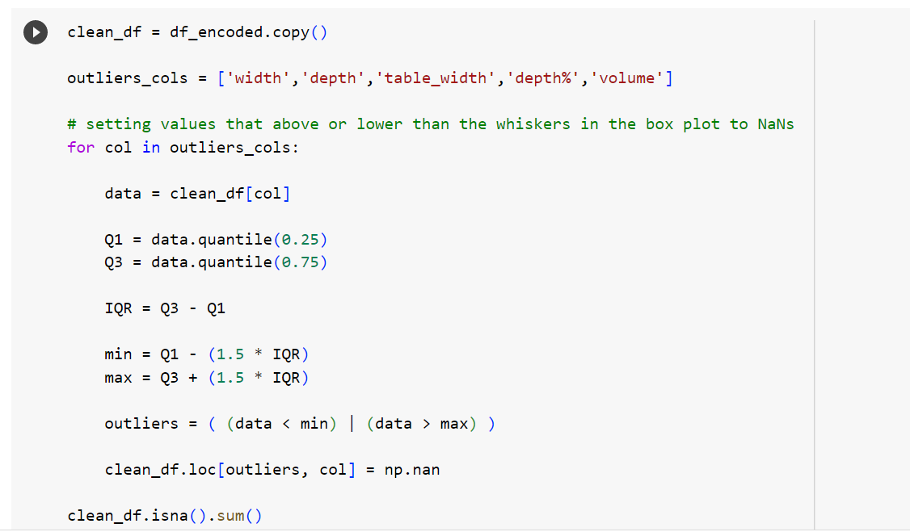
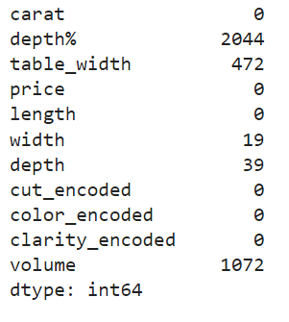
Data Cleaning & Preprocessing
Removing Outliers:

Slide 12
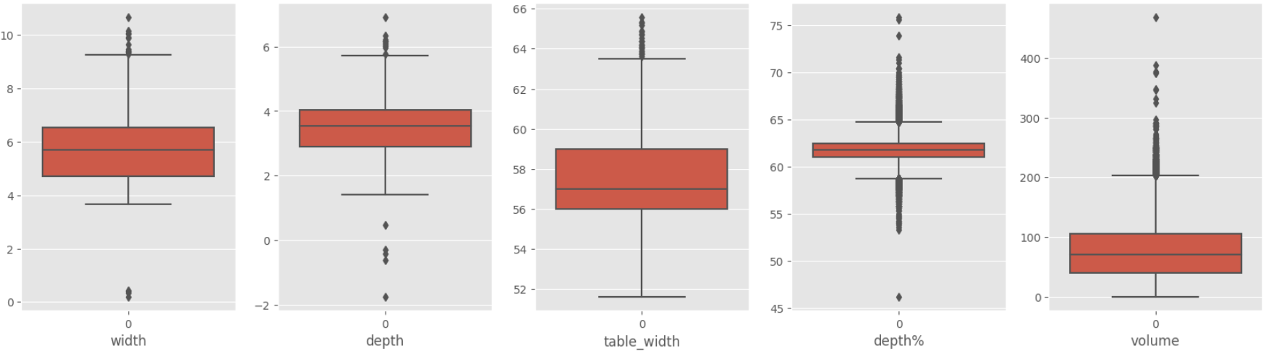
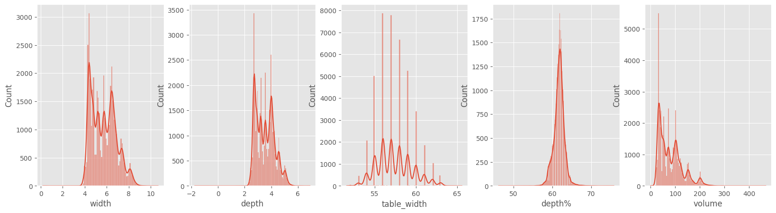
Data Cleaning & Preprocessing
Removing Outliers:
We can clearly notice the iterativeImputer
changes in the features,
the outliers and features skewness is nearly gone.
But not that much of a change in outlier on 'depth%'.

Slide 13
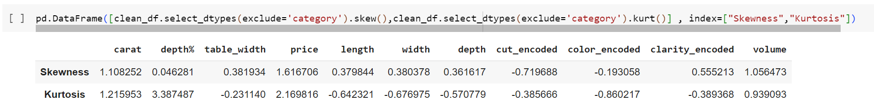
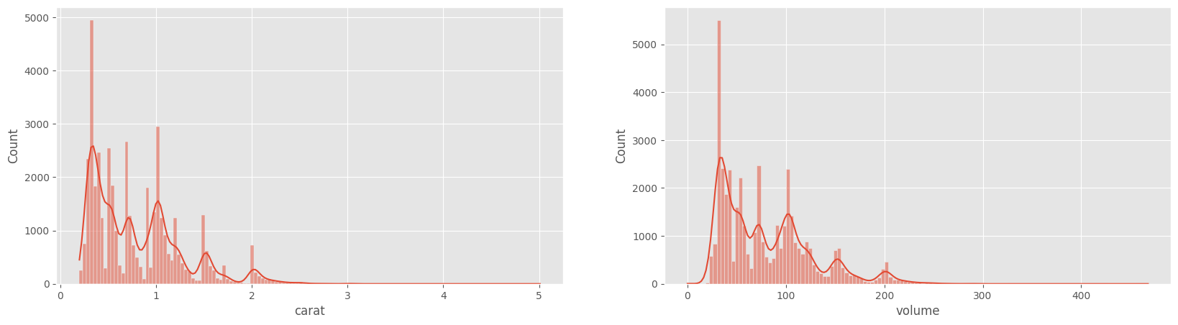
Data Cleaning & Preprocessing
Applying Log Transformation:

Slide 14
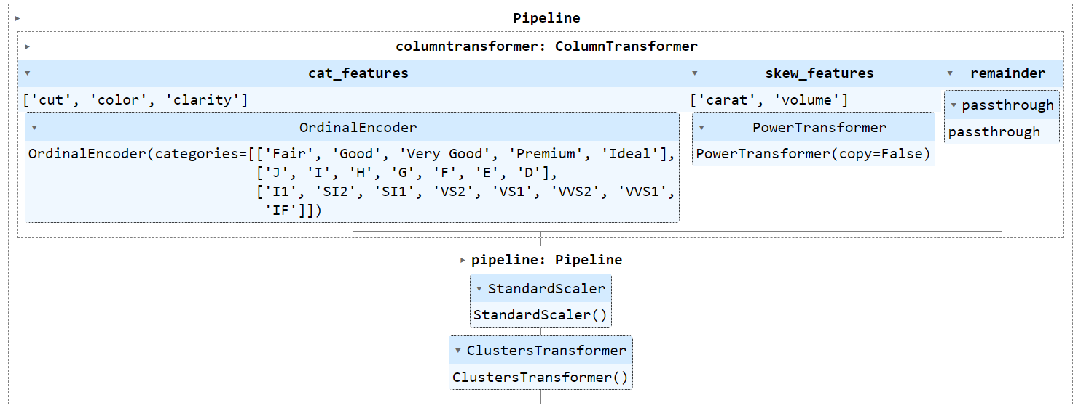
Data Cleaning & Preprocessing
Making Pre-processing Pipeline
We will make a pipelines for encoding categorical features and scaling for the numerical ones
along with transforming skewed features and creating new cluster feature.

Slide 15
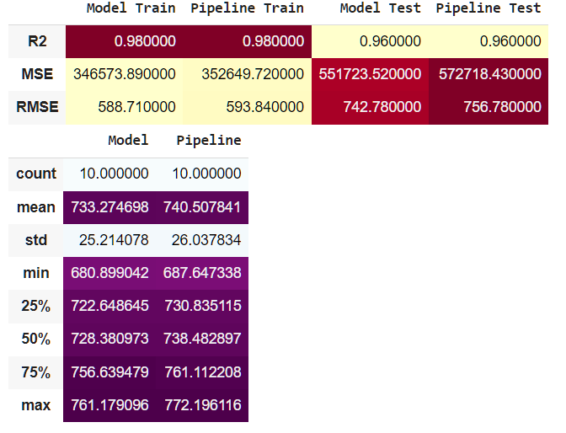
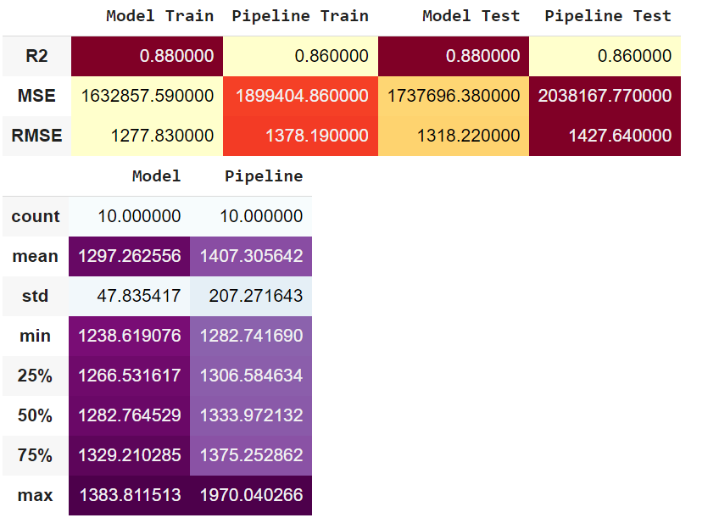
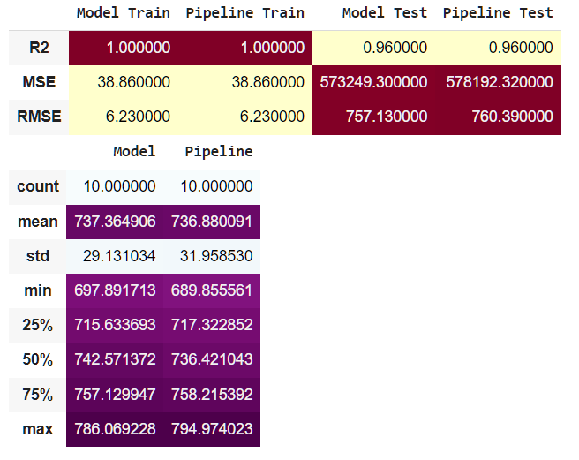
Modeling
Kneighbours
Linear Regression
Decision Tree

Slide 16
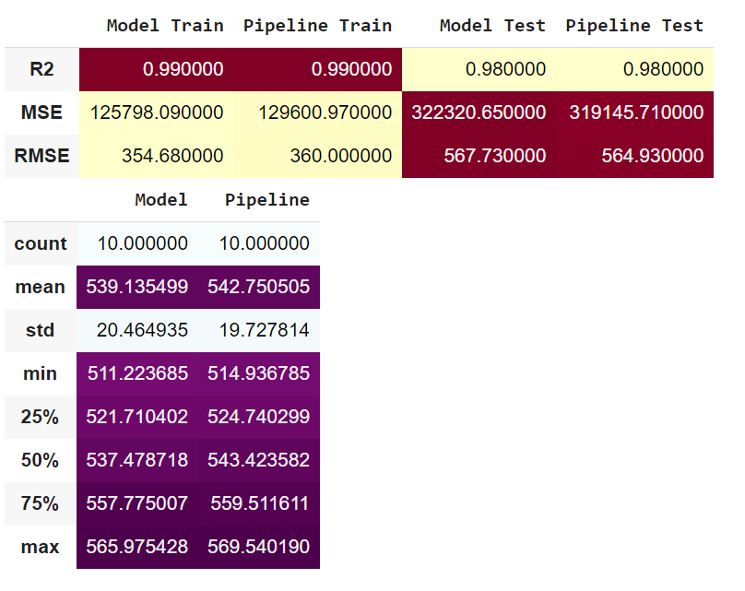
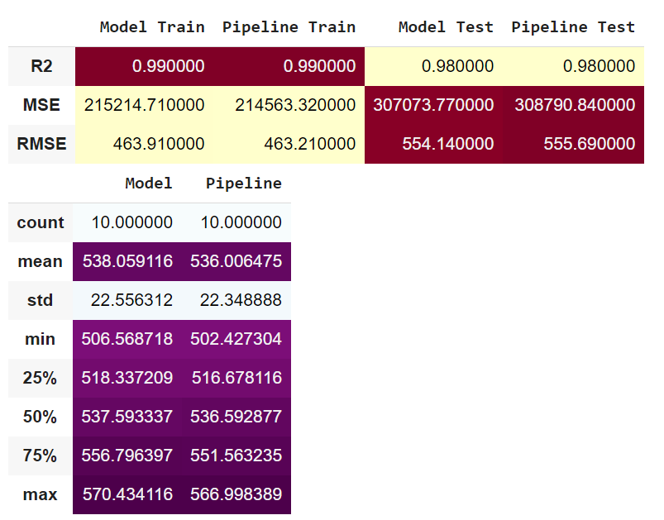
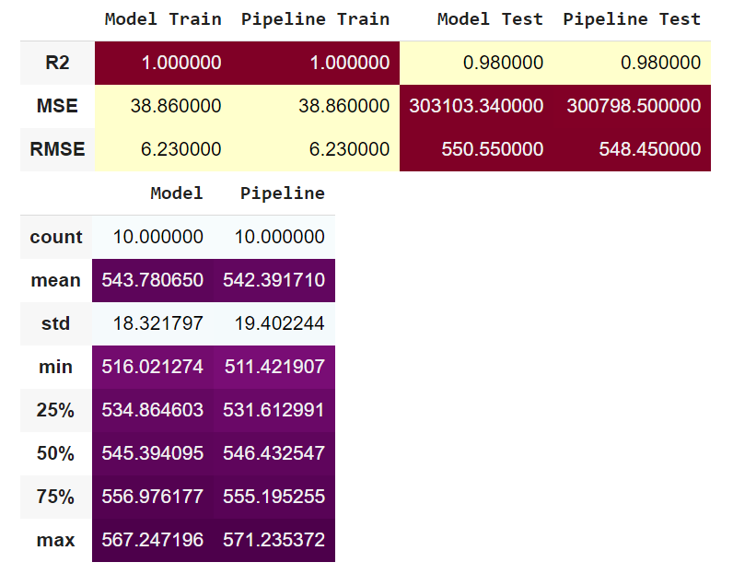
Modeling
ExtraTrees Regressor
LGBM Regressor
XGBRegressor

Slide 17
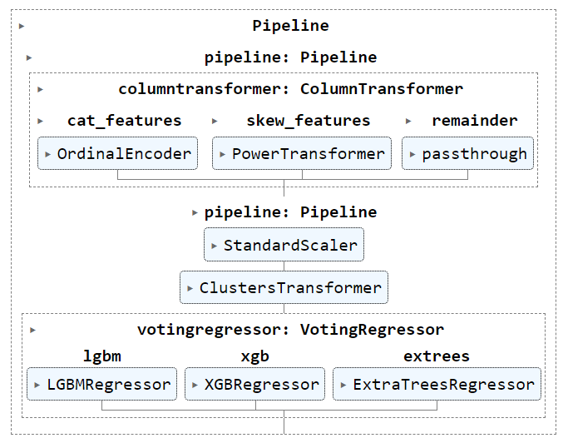
Final PipeLine
Kaggle Final Scores

Slide 18
QUESTIONS

Slide 19
SHAI For AI | شاي للذكاء الاصطناعي
Diamond Price Prediction
Project done by:
Imane ASSKOUR | Abdulrahman Khalid
Mohammed Salah | Boshra nasser

